Slide 1

IOT BASED GPS TRACKING SYSTEM WITH BLACK BOX
BATCH NO: 4
PROJECT MEMBERS
SURESH KUMAR J 812419104068
TONY CHRISTOPHER J 812419104071
NIRMAL KUMAR M 812419104701
PROJECT GUIDE Mr. A.JOSHUA ISSAC M.E.,
ASSISTANT PROFESSOR
Department of Computer Science and Engineering
1

Slide 2
OBJECTIVES
To build an integrated system for emergency rescue services in the event of road accidents by using black box system.
2

Slide 3
INTRODUCTION
In modern day vehicles accidents are one of the leading causes of fatalities.
Many kind of sensors are implemented in the vehicle and it is used in the real time applications effectively.
Focuses on building an infrastructure which vehicle safety authorities can enhance the crash reports post-crash analysis, record of the event and reduces the time to arrive at the crash location.
3

Slide 4
LITERATURE SURVEY
S.No | Title & Year | Author Name | Methodology | Merits | Demerits
1. | Navigation in GPS Spoofed Environment Using M-Best Positioning Algorithm & Data Association-2021 | Bethi Pardhasaradhi, Pathipati Srihari, And P. Aparna | Detection spooﬁng | To find the true target by imposing fake measurements | This assumption is not valid in reality.
2. | Real-time GNSS precise point positioning with smartphones for vehicle navigation-2021 | Zishen Li, Liang Wang, Ningbo Wang, Ran Li and Ang Liu | Precise Point Positioning (PPP) | To promote the application real time PPP with smartphone. | It is used to get live location only.
3. | GPS Based Vehicle Tracking System-2021 | Mohd Hakimi Bin Zohari. | GSM method | Wireless communication. | Short range communication.
4

Slide 5
4. | Accident detection alert system-2022 | Dr. C. K. Gomathy. | GPS and Accelerometer | Easy to locate the accident place. | Signal problem.
5. | Lane changing time point and path tracking framework for autonomous ground vehicle-2021 | Jiayu Fan. | Synthesized safety distance for lane changing. | It improve the vehicle stability and the efﬁciency of changing lane. | Cannot be applied for high speed driving.
5

Slide 6
EXISTING SYSTEM
GSM and GPS modules are used to find and send the location co-ordinates to first responders.
Vibration sensor is connected with Raspberry pie to identify the changes.
It can also read several vital parameters of the condition of the road.
6

Slide 7
DEMERITS OF EXISTING SYSTEM
Cannot cancel the alert message if crash is not severe.
Short range of communication.
Crash details cannot be recorded.
Implementation cost is high.
7

Slide 8
PROPOSED SYSTEM
The Multi sensors are used in vehicle to detect and inform through IOT and GPS in black box module.
Panic switch use to control the sending information.
The information will been sent to nearby police station or hospital or home.
Event of crash is stored in webpage and server.
8

Slide 9
MERITS
The vehicle safety authorities can enhance the crash reports for post- crash analysis of the event.
Multiple sensors are used for multiple purposes with help of GPS and IOT Module.
Implementation cost is low.
9

Slide 10
ARCHITECTURE
Black Box
Vibration range
0 to 1024
Crash detection
Temperature & Gas
SW-420 (VS)
Power Supply
Node MCU
Location
Coordinates
Panic Switch
5 Seconds
NEO-6M (GPS)
Arduino Uno
DHT11 (TS)
SMS
Webpage & Server
MQ-6
(GS)
Node MCU
10

Slide 11
MODULES
Vibration detection
Data Acquisition
GPS Module
Message alert
11

Slide 12
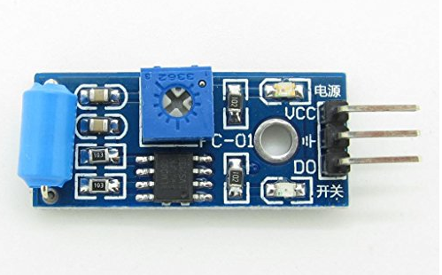
VIBRATION DETECTION
MODULES DESCRIPTION
Vibrational changes of the vehicle is monitored using the SW-420 (Vibration Sensor).
The vibration sensor triggers the Neo-6m GPS, DHT11 and MQ-6 sensors.
12

Slide 13
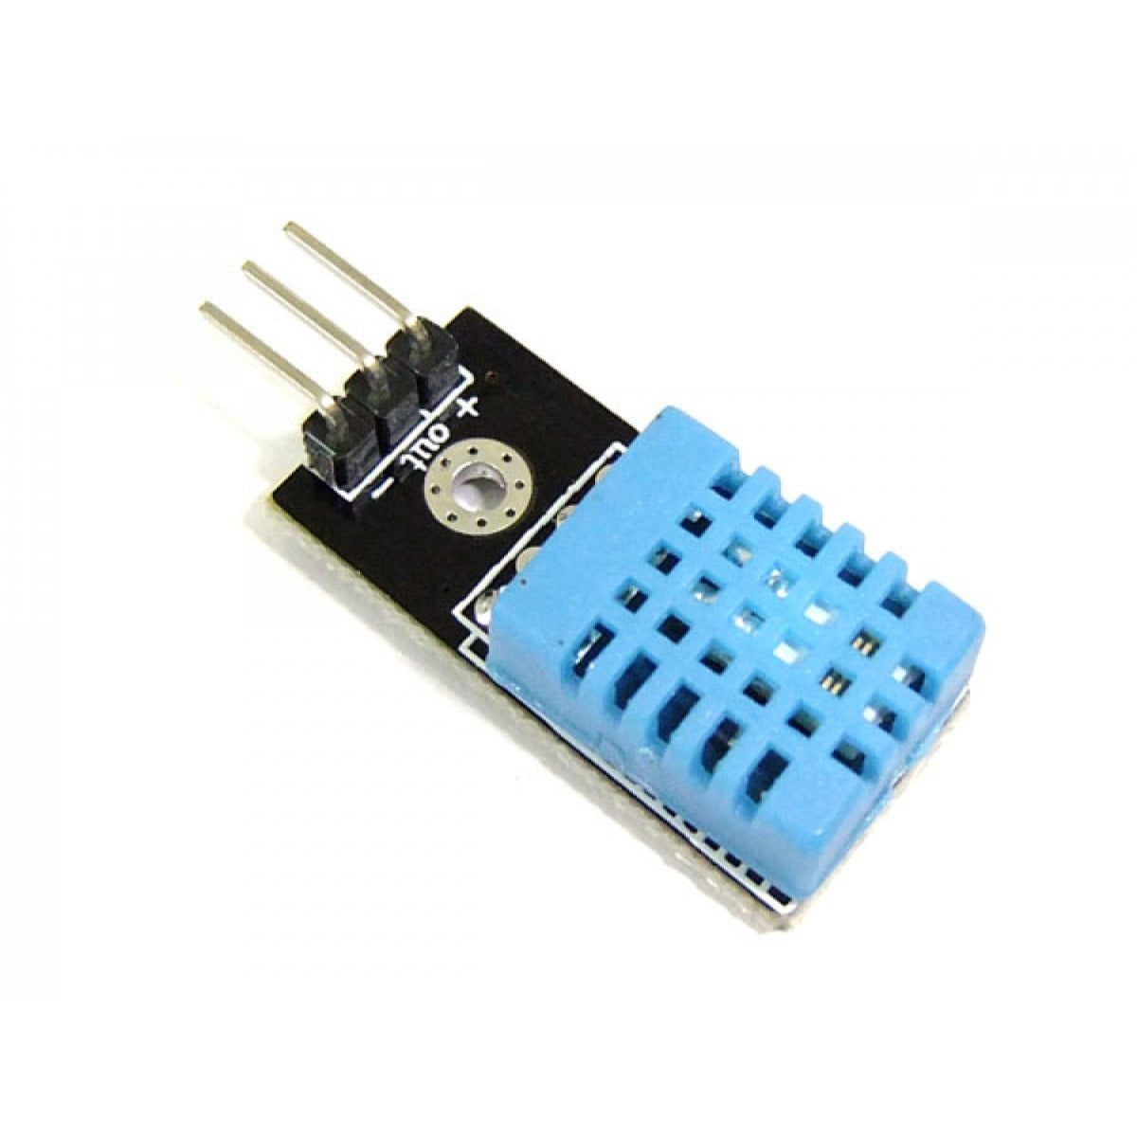
DATA ACQUISITION
1. DHT11 (TS)
The DHT11M temperature sensor is a low-cost digital sensor that can measure temperature and humidity with high accuracy.
It is used to measure the changes in temperature of the vehicle.
13

Slide 14
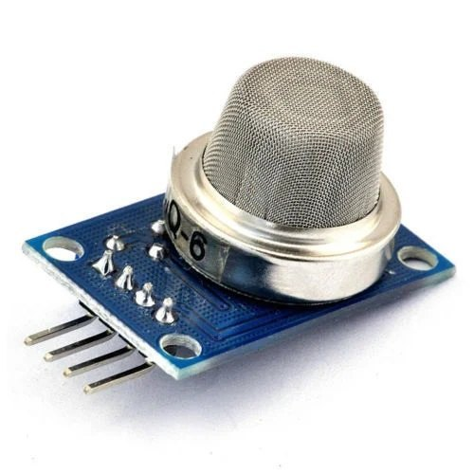
2. MQ-6 (GS)
The MQ-6 gas sensor is a small size and low power consumption, making it portable.
To detect the presence of gas leaks, the MQ-6 gas sensor is frequently employed in black box devices.
The black box can reveal crucial information regarding the cause of an accident by detecting the presence of any of these gases.
14

Slide 15
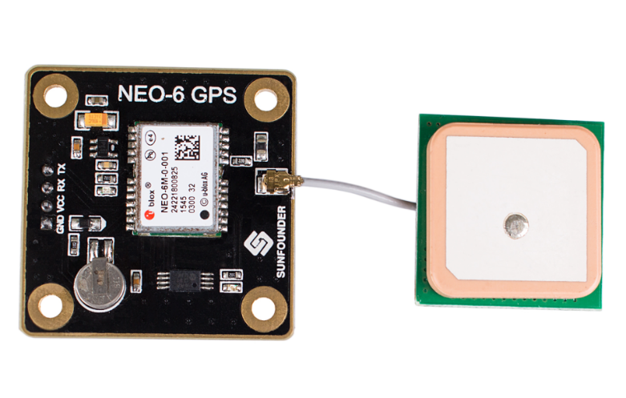
GPS MODULE
Satellite based navigation system that provides the exact time information and location anywhere, anytime 24 hours a day and in all-weather condition.
The GPS Neo-6m module can send the location coordinates to the Arduino Uno.
15

Slide 16
MESSAGE ALERT
The Message alert of the accident occurred will be transmitted with the help of ESP8266 (Node Mcu).
The message alert will be sent to emergency contact number.
16

Slide 17
MODULE DIAGRAM
Vibration detection
Getting gas and temperature data
Transmitting location coordinates
Stores data in Webpage & server
Sending message alert
17

Slide 18
CONCLUSION
An IoT GPS tracking system with a black box is a powerful tool to track and monitor assets, vehicles and people in real time.
The technology offers real-time location information as well as extra knowledge that can boost operational effectiveness, cut costs, and increase safety and security.
18

Slide 19
FUTURE ENHANCEMENT
On the basis of two desired outcomes, the work will be developed:
Geo-fencing
Enhanced security
This could be achieved via the use of advanced sensors, algorithms powered by AI and other technologies.
19

Slide 20
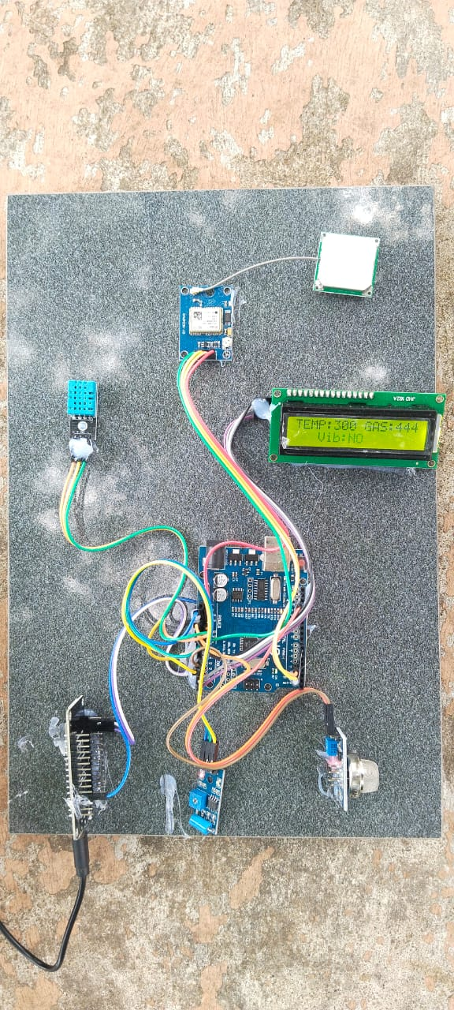
OUTPUT
Fig 1: Project being tested
20

Slide 21
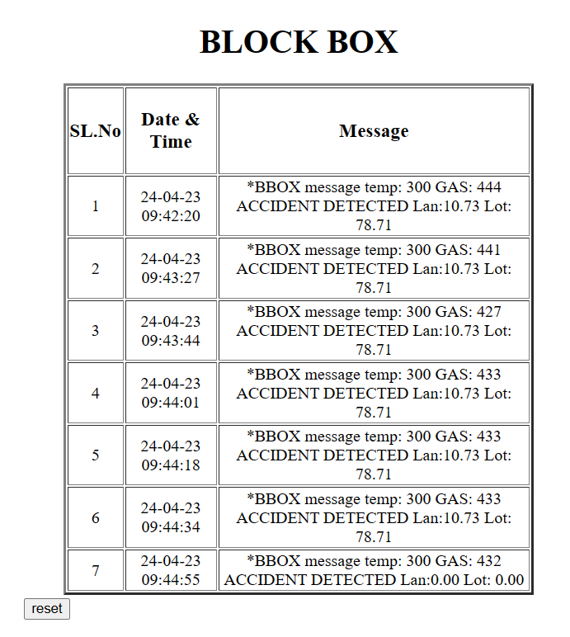
Fig 2: Data stored in Webpage
21

Slide 22
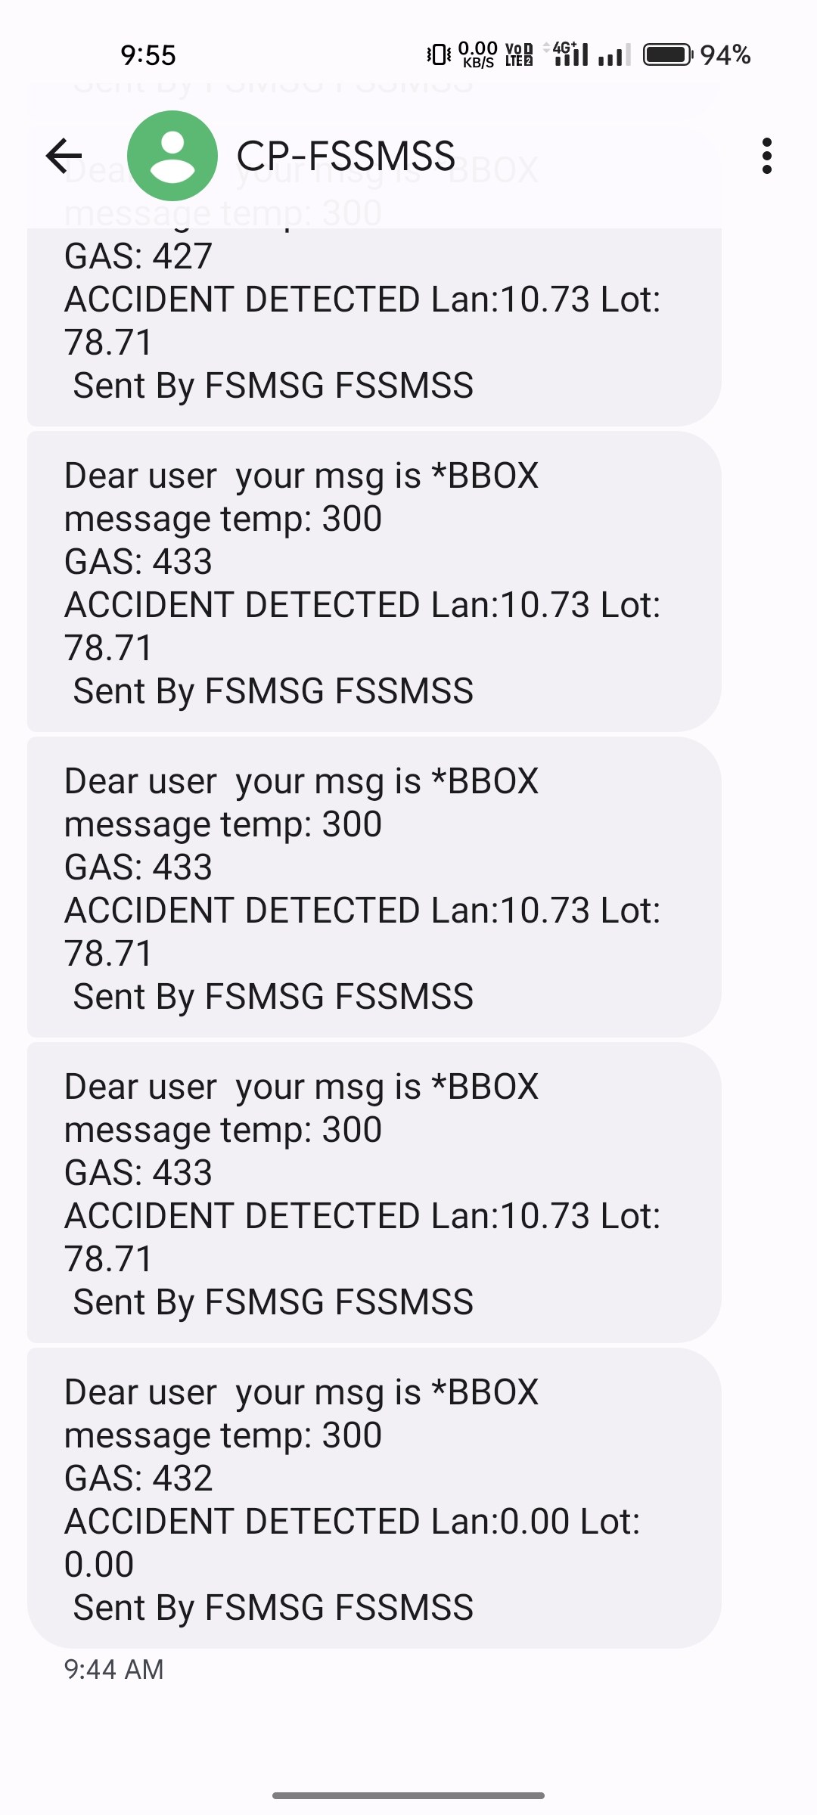
Fig 3: Message of location coordinates
22

Slide 23
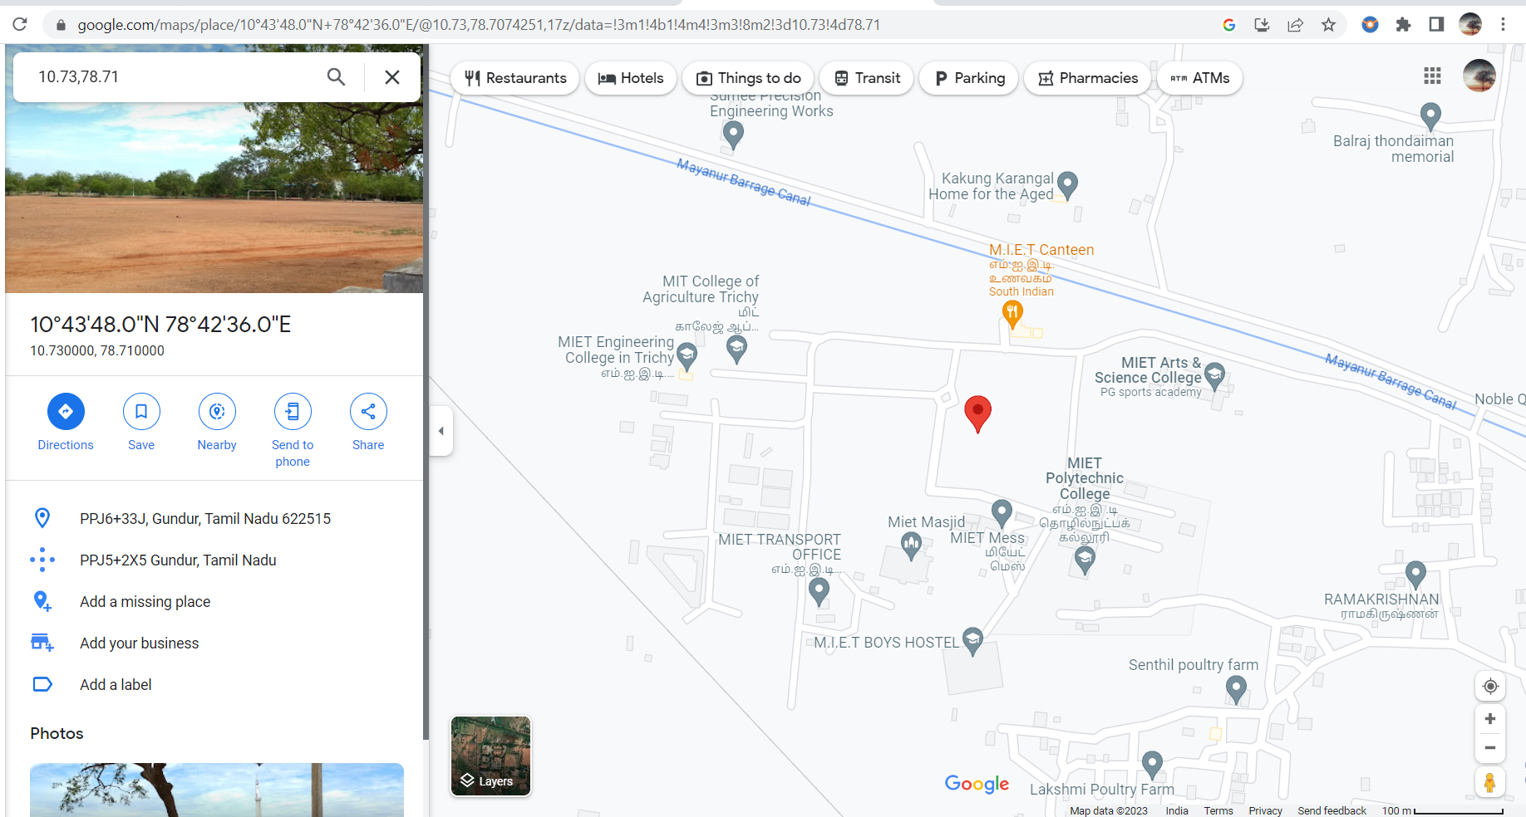
Fig 4: Location of Vehicle
23

Slide 24
REFERENCES
[1] Sathe Pooja, Vehicle Tracking System Using GPS‖, International Journal of Science and Research (IJSR), India Online ISSN: 2319-7064, 2013.
[2] Abha Damani, Hardik Shah, Krishna Shah, Manish Vala, Department of Computer Science and Technology, Uka Tarsadia University,Bardoli, Gujarat ― Global Positioning System for Object Tracking‖ International Journal of Computer Applications (0975 – 8887) Volume 109 – No. 8, January 2015.
[3] Pankaj Verma, J.S Bhatia, Centre for Development of Advanced Computing, Mohali, Punjab, India ―Design and Development of GPS-GSM Based Tracking System with Google Map Based Monitoring‖ International Journal of Computer Science, Engineering and Applications (IJCSEA) Vol.3, No.3, June 2013.
24

Slide 25
[4] A. EI-Rabbany, Introduction to GPS: The Global Positioning System, Norwood, MA: Artech House, 2006.
[5] Pham Hoang Oat, Micheal Drieberg and Nguyen Chi Cuong, ―Development of Vehicle Tracking System using GPS and GSM Modem‖ Electrical and Electronics Engineering Department, Universiti Teknologi PETRONAS, Malaysia. 2013 IEEE Conference on Open Systems (ICOS), December 2 - 4, 2013, Sarawak,
25

Slide 26
THANK YOU
26

